Slide 1
Tracking People by Predicting 3D Appearance, Location & Pose
Presenter: Rafael Seroussi
9/8/2022

Slide 2
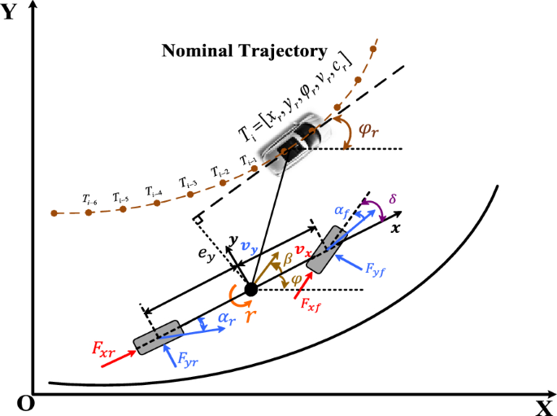
Motivation: 3D Objects in a 3D world
The premise follows the idea of two simple human concepts:
Object permanence
predictive tracking

Slide 3
Motivation Cont.
Robots need to learn to function in real world situations. Objects don’t disappear when you stop looking at them!
Robots should be able to predict where an object might be for say avoidance
The big societal issue has to be tracking of people, which the paper writers are aware of but don’t seem concerned.

Slide 4
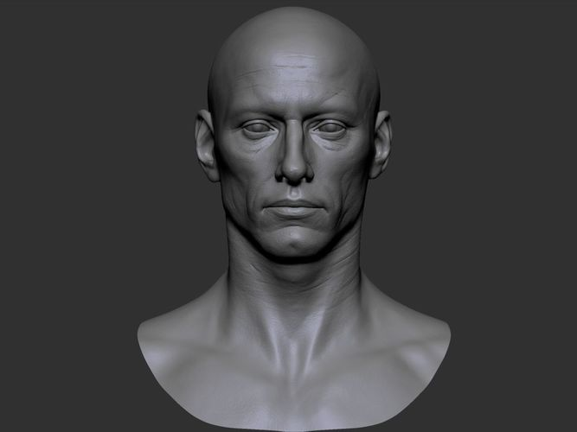
Technical Challenges
Two past works are referenced:
Object tracking has a long history, especially in the 2D space.
Monocular 3D human reconstruction: Image by Image reconstruction of a person to 3D models, heavily used in this work
No current work seems to blend the tracking
problem with past information

Slide 5
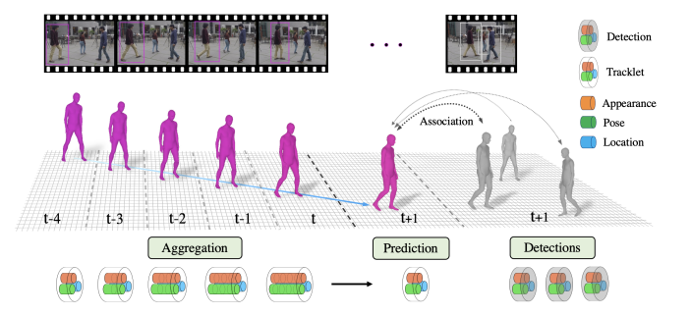
Problem Setting
1 or more slides
Problem formulation, key definitions and notations
Individual tracking of a single person, known as
a “tracklet” in this paper.
PHALP: Predicting Human Appearance, Location and Pose for Tracking
HMMR : A temporal version of the HMR or Human Mesh Recovery
HMAR : Head motion-associated virtual stereo rearview
Transformer - Attention is all you need
3 big variables that are focused on for this work: Location, Appearance, and Pose of the tracklet

Slide 6
Context / Related Work / Limitations of Prior Work
1 or more slides
Which other papers have tried to tackle this problem or a related problem?
3D human reconstruction from image
Tracking
Some prior works in tracking actually sound like they do something very similar
Pavel Tokmakov, Jie Li, Wolfram Burgard, and Adrien Gaidon. Learning to track with object permanence. In ICCV, 2021.
Tarasha Khurana, Achal Dave, and Deva Ramanan. Detecting invisible people. In ICCV, 2021

Slide 7
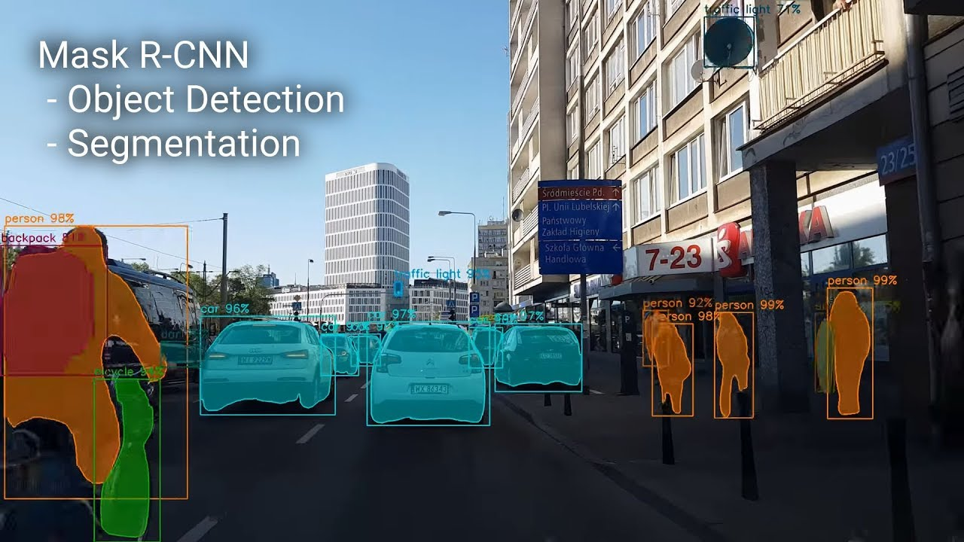
Algorithm: Single frame processing
Broken up into 3 main pipelines
Input to the system is a frame from a video
The video frame is run through a Mask-RCNN for object detection with segmentation mask

Slide 8
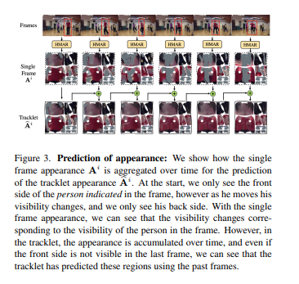
Algorithm: Tracklet Predicted Appearance
Appearance pathway:
The image aggregate at time t
The UV image and the visibility map are summed over time

Slide 9
Algorithm: Tracklet Predicted Location
Location is expressed not in Euclidean coordinates but in (x,y,n), where n is nearness (a parameterization of depth in an image)
classic regression problem with 4 dimensions
do the same for y and n

Slide 10
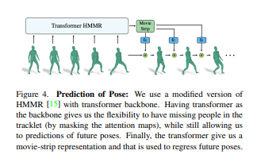
Algorithm: Tracklet Predicted Pose
A temporal pose aggregation function
take a series of embedded poses
compute a temporal pose embedding

Slide 11
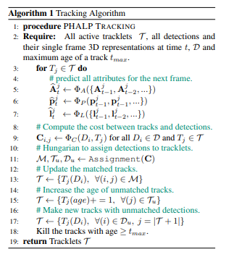
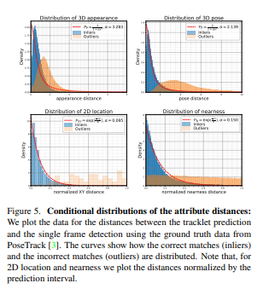
Algorithm: Tracking with the predicted 3D representations
The tracking requires a similarity score between predicted pose and actual final pose
just combining all 3 attributes would not be ideal
estimate the cost function using the
Hungarian Algorithm

Slide 12
Theory (if relevant)
What are the assumptions made for the theory? Are these reasonable? Realistic?
If the theory build strongly on other prior theory / results, reference those and state them here.

Slide 13
Theory (if relevant, continued)
State main results formally
Give proof sketches
Refer students to the full proofs in paper

Slide 14
Experimental Setup
evaluation settings:
3 datasets were used for testing: PoseTrack, MuPoTS, and AVA
Uses an off the shelf RCNN from Kaiming He, Georgia Gkioxari, Piotr Dollar, and Ross Gir- ´ shick. Mask R-CNN. In ICCV, 2017
compared to Trackformer, Tracktor, AlphaPose, FlowPose, T3DP, PHALP
evaluation metrics:
reported results using IDentity switches (IDS), Multi-Object Tracking Accuracy (MOTA), ID FI score (IDFI) and HOTA. adopt the protocols of Rajasegaran for evaluation

Slide 15
Experimental Results

Slide 16
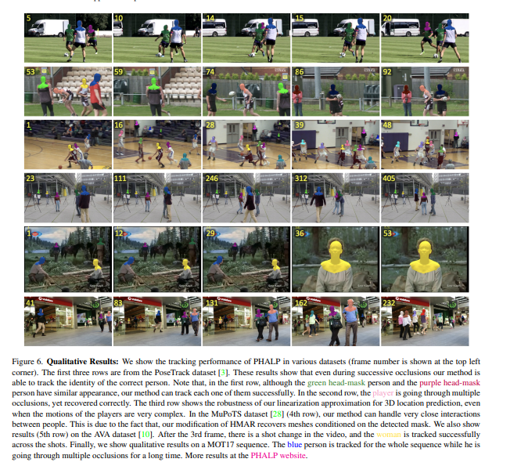
Experimental Results:

Slide 17
Discussion of Results
Conclusions
A better than cutting edge human tracker
Only need to tune 5 parameters for the association aspect, very good for multi-object tracking datasets where annotating people is expensive.
The results are backed by the experimental results, the difference is max %4 between PHALP and other state of the art tracking methods

Slide 18
Critique / Limitations / Open Issues
Intensely computationally expensive. However The whole regression scheme seems like a decent way to combine two approaches into one cohesive tracker.
It doesn’t seem to give throughput, but I would be surprised if it got 5 fps which is max for mask-RCNN.
Ethically debatable, tracking people is a huge privacy concern at the moment.

Slide 19
Future Work for Paper / Reading
What interesting questions does it raise for future work?
the whole idea of object permanence could be used for automated driving, pose, location, and shape of a vehicle are very important. It would have to be faster though
Posetrack, MuPoTS, AVA are all similar datasets that were used in this paper. Trackformer, Tracktor, AlphaPose, FlowPose, T3DP are all trackers that can be looked up for further reading

Slide 20
Extended Readings
Tim Meinhardt, Alexander Kirillov, Laura Leal-Taixe, and Christoph Feichtenhofer. Trackformer: Multi-object tracking with transformers. arXiv preprint arXiv:2101.02702, 2021.
Philipp Bergmann, Tim Meinhardt, and Laura Leal-Taixe. Tracking without bells and whistles. In ICCV, 2019
Hao-Shu Fang, Shuqin Xie, Yu-Wing Tai, and Cewu Lu. RMPE: Regional multi-person pose estimation. In ICCV, 2017
Yuliang Xiu, Jiefeng Li, Haoyu Wang, Yinghong Fang, and Cewu Lu. Pose Flow: Efficient online pose tracking. arXiv preprint arXiv:1802.00977, 2018
Jathushan Rajasegaran, Georgios Pavlakos, Angjoo Kanazawa, and Jitendra Malik. Tracking people with 3D representations. In NeurIPS, 2021

Slide 21
Summary
Approximately one bullet for each of the following
Tracking Humans in video
Tracking People is a multi layer problem which includes object detection, tracking,
Previous work didn’t do any temporal analysis, while PHALP does and makes marginal improvements
4% max increase over the next best T3DP
Cutting edge technique

